Slide 1

Choosing Wisely
An in depth study of NBA centers from the US and the EU.

Slide 2

The Goal
The aim of this project is to allow NBA teams to make more informed decisions when drafting or trading for an NBA center.
The project compares the strengths and weaknesses of NBA centers from the US and the EU and creates machine learning models for major statistical categories to aid in predicting player performance.

Slide 3
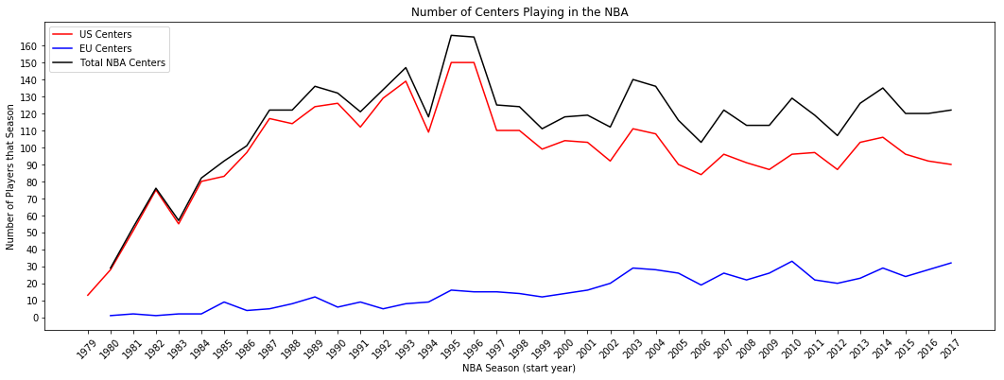
Significance of NBA Centers
The ever increasing number/ratio of ‘European big men’ in the NBA makes it imperative to consider the relative strengths and weaknesses of NBA centers.

Slide 4
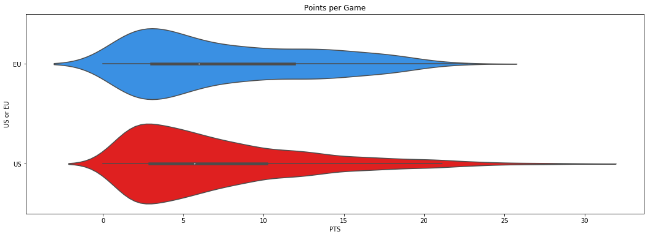
Comparing Points
As a population, EU players are very much like US players. Having a very similar ‘Points per Game’ (PTS) distributions. However, given the wider interquartile range of EU players, on average, an EU player earns a higher ‘Points per Game’ seasonal average.

Slide 5
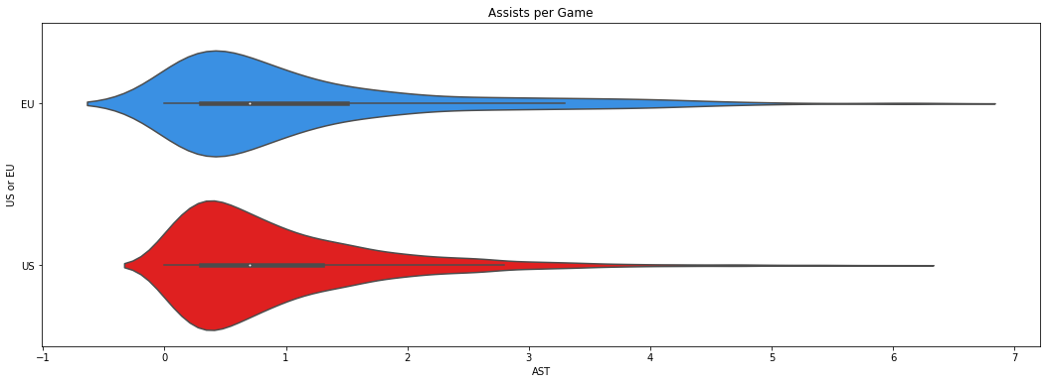
Comparing Assists
Same story as before, as populations, both are very much alike, with EU players having a larger IQR, but once again the differences are miniscule. Other seasonal statistical averages (Rebounds, Steals, Blocks, Turnovers, Fouls) follow a similar trend.

Slide 6


Statistical Findings
-From a statistical standpoint, as populations, US and EU centers are very much alike in the aggregate in all major statistical categories.
- Thus, drafting for an EU center is no less a risk than drafting a US center, and the stigma/backlash associated with drafting an international player is unjustified.
We will now move on to the machine learning models
and describe how they can be leveraged to predict (within an uncertainty interval) the Points, Assists and Rebounds averages for any given player (amongst other statistics).

Slide 7
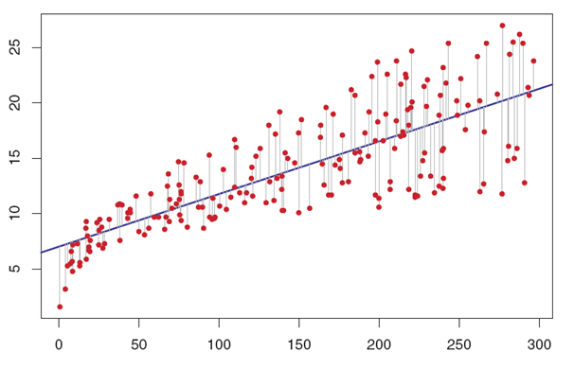
Machine Learning Methodology
The model chosen for the project is multiple linear regression. The model ‘trains itself’ by minimizing the sum of squared residuals. Residuals are demonstrated in the graph on this page and are defined as the difference between the real value and the predicted value of the model.
The ‘Per Game’ table on https://www.basketball-reference.com/players/o/onealsh01.html provides an example of the data used to train the model.
We will provide instructions on how to use the models in later slides, but before that we will cover their performance and details on how to interpret the results.
Fig 1. Visual representation of residuals

Slide 8
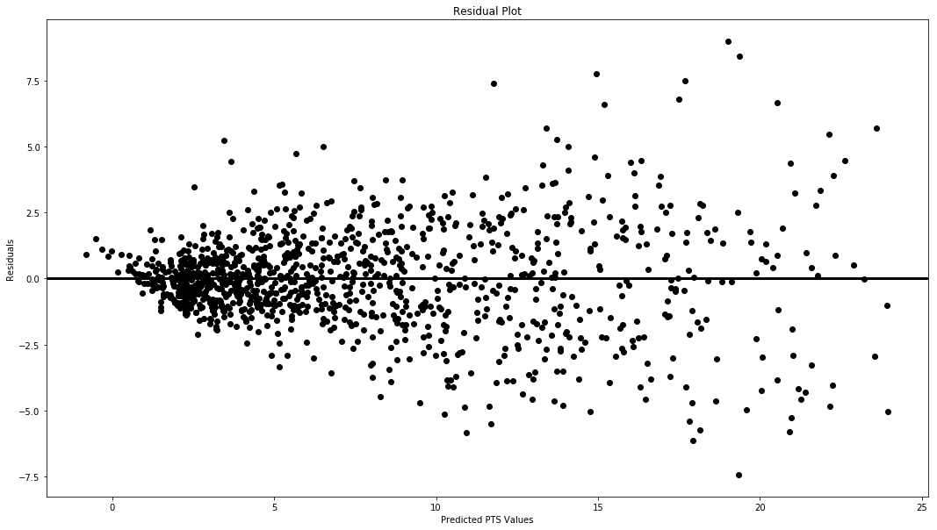
Points per Game (PTS) Model
The residual plots (on the right) shows the distribution of residuals based on the predicted value of the model. In the ideal case the distribution is completely random.
Given a predicted value one can see the distribution of residuals and infer the confidence interval for a given prediction. So for example for a prediction of 10 PTS, we can see the maximum deviation is +-5, thus we can be sure that the players’ seasonal average will be in the interval [5, 15] Points per Game.

Slide 9
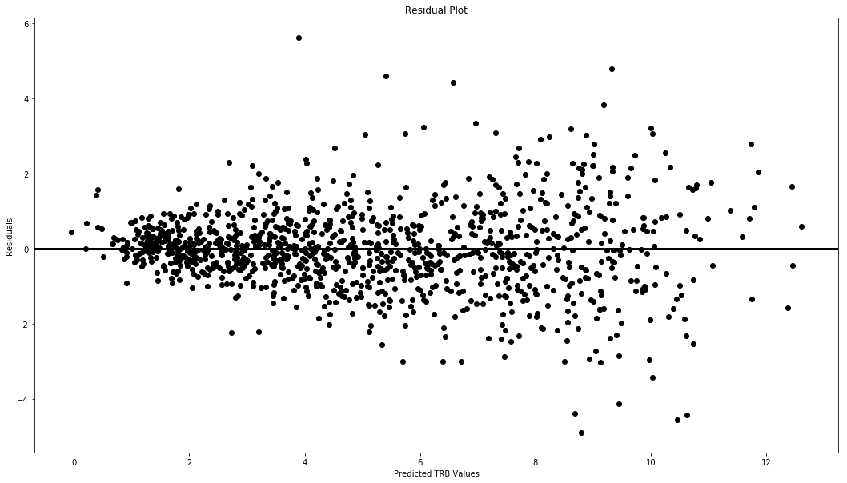
Rebounds per Game (TRB) Model
Like with the Points per Game model in the previous slide, the same interpretations hold here.
This time the model has a more uniform distribution of residuals allowing for a simpler interpretation of the predictions.
Other residual plots are available in the Python Notebook.

Slide 10

Final Conclusions/Recommendations
Conclusions:
-US and EU centers playing in the NBA are effectively identical as a population in the statistical sense, rendering the country of origin as irrelevant with regards to player performance.
-Predicting player performance is simple providing the user is familiar with scikit-learn. Evaluating the predictions and their reliability is made easy with Residual Plots present in the Jupyter Notebooks of the project.
Recommendations:
- The needs and requirements of each NBA team and its front office differ with regards to what they look for in an NBA center. The project is thus a tool for evaluating the future performance of a player, given the requirements of the individual using the models. Given that some models perform better than others, it’s important to be acutely aware of the caveats of the models (seen in the residual plots) to avoid false interpretations of the results.

